Slide 1
Language and Persuasion

Slide 2
Not WHAT you say, but HOW you say it…
A good part of our persuasive success can depend on how we express ourselves using (or not using) certain types of words or language.
What makes the difference between a good public speaker and a terrible one?
Contrast most people’s first speech in COM 114 with Martin Luther King…!

Slide 3
Today’s lecture
How vividness, intensity, profanity, and powerful speech affect persuasion.
What “political correctness” is and how it affects persuasion.
The power of language to completely reframe an issue and change people’s minds about their social and political issues.
How the “message sensation value” of anti-drug PSAs can make kids who are at risk for experimenting with drugs think twice.

Slide 4
Language and Persuasion
There are several primary areas of communication research in the area of language and persuasion:
Vividness
Intensity
Profanity
Powerlessness

Slide 5
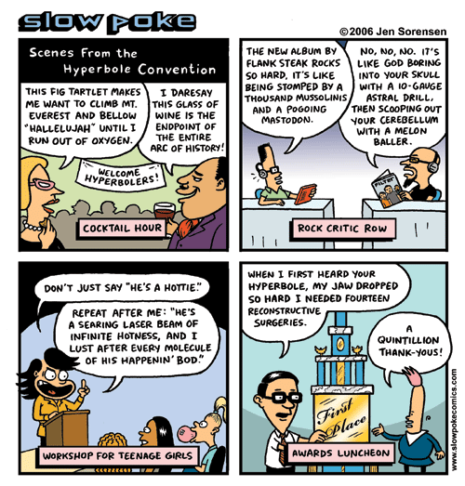
Vividness
Vivid language creates a picture in people’s minds.
The use of vivid imagery can make a message more persuasive as long as it is relevant to the message topic or goals.
How could you say, “I had a great October Break” in a vivid way?
“I lounged like a lizard in that blazing Miami sun.”

Slide 6
A review of Bradbury’s “Dandelion Wine”
Matt gave it 5 stars on Goodreads: “Sure, it's overly sentimental and largely ignores the social problems of the time depicted, but when you're 12 years old in small-town America, there are no social problems. There are only problems regarding the new pair of tennis shoes you want, the creepy guy who hangs out in the ravine, the desire to live forever, to be young forever, to build the perfect happiness machine. Besides, Bradbury's writing is so rich it practically drips, much like biting into a perfectly ripe peach in August.”

Slide 7
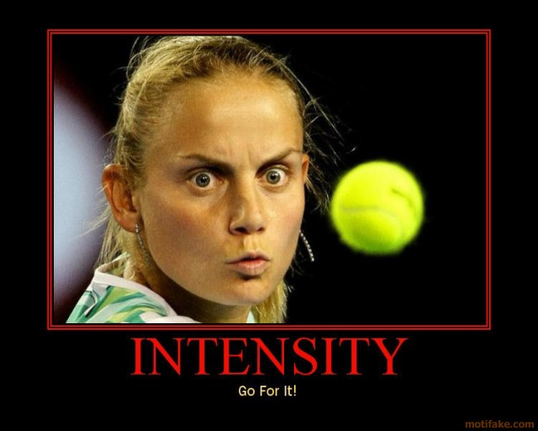
Intensity
Intense language is emotional, metaphorical, opinionated, forceful, and evaluative.
Intensity is “the degree to which language deviates from neutrality.”
Vivid language often plays into intensity, but can include other types of language that are simply opinionated or even profane.
“If I don’t get away from this rotten weather and these miserable people, I’m going to tell my boss to shove this job.”

Slide 8
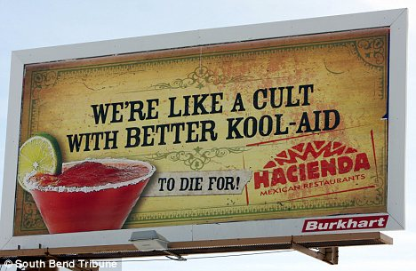
What makes this billboard intense?

Slide 9
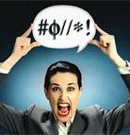
Profanity
The use of profanity turns out to be fairly common.
It can command attention, discredit an opponent, provoke violence, foster identification with a group, and provide catharsis.
The use of profanity can harm your credibility if you do not have power.

Slide 10
Definition of Powerless Speech
Powerless speech: The inclusion of characteristic speech patterns that detract from direct and straightforward presentation of material.
Powerful speech: The exclusion of powerless characteristics.

Slide 11
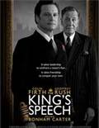
Powerful and Powerless Speech
Interest began with observations about the differences in the ways that men and women talk.
We use language to make social evaluations.
Where person is from, class background, credibility, etc.
The research focus is on the way we speak, not what we say.
http://www.youtube.com/watch?v=p1TubkzxPFY
1:08-1:39
http://www.youtube.com/watch?v=jqOfuZzgIP4
(12:12 to 12:49)

Slide 12
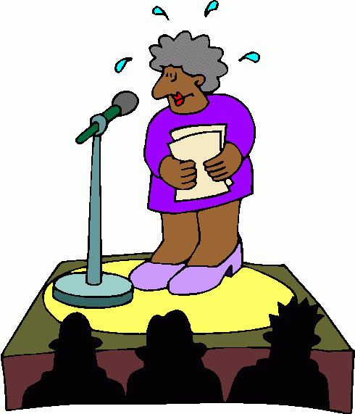
Important Types of Powerless Speech
Hedges
Hesitations
Tag questions
Disclaimers

Slide 13
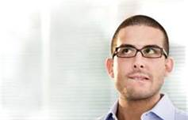
Hedges
Words or phrases which qualify or reduce the force or a statement (sometimes, sort of, kind of...).

Slide 14
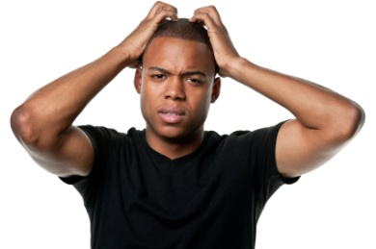
Hesitations
Markers of uncertainty (uh, ah, well, um, you know...).

Slide 15
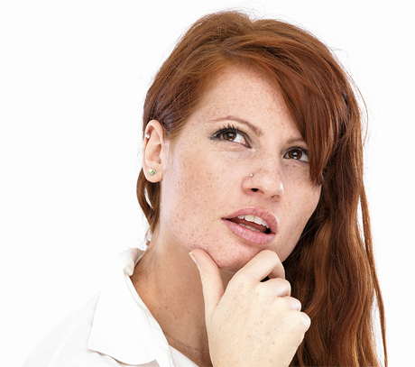
Tag Questions
Process of adding a question phrase at the end of a direct statement (isn’t it?). Detracts from the force of statement.

Slide 16
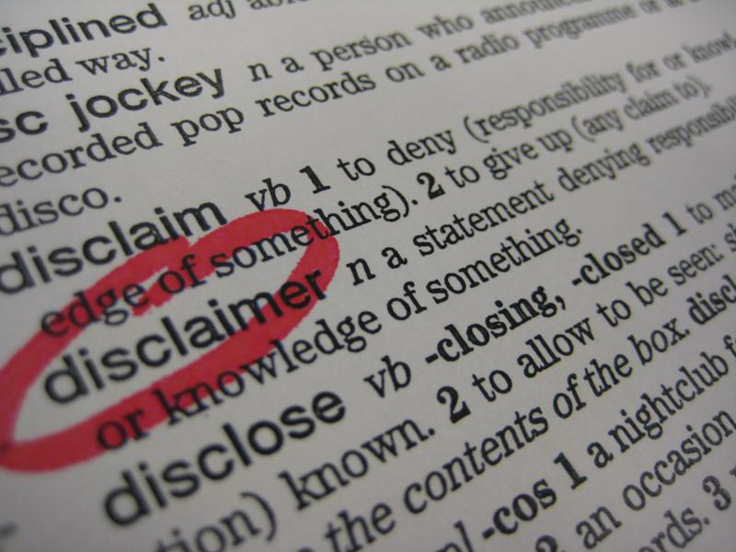
Disclaimers
Introductory expressions that excuse or explain or request understanding or forbearing .
Don’t get me wrong, but …; I know this sounds crazy, but ...
Demonstrates lack of commitment and uncertainty about a position.

Slide 17
General Findings and Implications
The use of powerless speech generally decreases ratings of:
credibility
attractiveness
persuasiveness
dominance
competency
believability
And increases perceptions of guilt in interrogations or legal contexts.

Slide 18
Important points and exceptions
No clear link to gender, but powerless speech may affect women more negatively than men EXCEPT in situations where women are expected to be polite and deferential.
Powerless speech is not always status related. New situations can induce powerless speech.
Ex: testifying in court
Low status speakers who use powerful speech are deemed as credible as high status speakers.

Slide 19
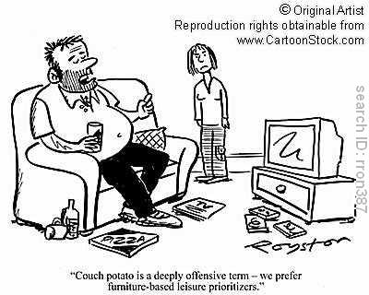
Political Correctness
“Political correctness” is a form of polite speech.
Generally, when applied to groups of people, it entails demonstrating respect for marginalized or stigmatized populations.
The majority population often resents having to “kowtow” to people who do not have a socially recognized claim to power.

Slide 20
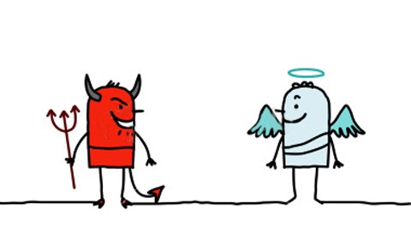
Reframing Effects
Politicians are masters of reframing through the careful use of language.
“God Terms”
What we value most in our culture: family values, balanced budget, personal responsibility
“Devil Terms”
What we fear most in our culture: Communism, Nazis, terrorists
“Charismatic Terms”
Abstract terms that have a magical aura: Freedom, democracy

Slide 21
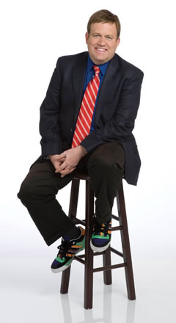
Reframing, continued
Some examples of highly effective reframing using language:
Estate tax → “Death tax”
Tax cuts → “Tax relief”
Global warming → “Climate change”
Frank Luntz 1
http://www.youtube.com/watch?v=4Yz8UwRsWPA
Frank Luntz 2
http://www.youtube.com/watch?v=6U4TLZRK2Ek
Words that start with “r” or end with “-ity” are good. “Prosperity,” “reform,” “accountability,” “responsibility” are examples.

Slide 22
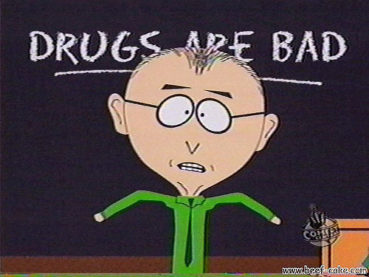
Message Sensation Value
Communication can be used in other ways to create more powerful messages.
Which anti-drug PSAs (public service announcements) do you recall seeing on television?
The messages you think are effective are (in part) linked to your level of sensation seeking.

Slide 23
How high is your level of sensation seeking? Answer Yes or No to each of the following questions:
1. I like to have new and exciting experiences and sensations even if they are a little frightening.
2. I like doing things just for the thrill of it.
3. I sometimes do "crazy" things just for fun.
4. I sometimes like to do things that are a little frightening.
5. I enjoy getting into new situations where you can't predict how things will turn out.
6. I'll try anything once.
7. I prefer friends who are excitingly unpredictable.
8. I like "wild" uninhibited parties.
9. I would like the kind of life where one is on the move and traveling a lot, with lots of change and excitement.
10. I am an impulsive person.
11. I like to explore a strange city or section of town by myself, even if it means getting lost.
12. I would like to take off on a trip with no preplanned or definite routes or timetables.
Add up the number of times you responded “yes” to the above questions. Divide by 12.
00 - 27% = Very Low 28 - 41% = Low 42 - 70% = Average 71 - 84% = High 85 - 100 = Very High

Slide 24
Audience-centered message design: Message Sensation Value
Problem: High sensation seekers are up to 10 times as likely to experiment with drugs.
A bigger problem: Most anti-drug PSAs suck.
The question: What makes some anti-drug PSAs better than others? Lab rat vs. Bush
The research:
Content analysis of 110 PSAs on all the dimensions that might make a difference
Experiment to test whether high MSV PSAs are more effective than low MSV PSAs

Slide 25
Dimension/Feature | Scoring | Description
Visual
Cuts | Count of cuts; also converted to low (0-6 cuts), moderate (7-14 cuts), and high (more than 15 cuts) levels | The number of times the camera cuts from one visual scene to the next. Includes the final cut to agency sponsor at the end of the PSA.
Special visual effect | 0/1 (absent/present) | Anything beyond the range of human ability and involves special visual effects, including morphing, paint or blood “sliding” down the screen, or computer manipulation of images.
Slow motion | 0/1 (absent/present) | The slowing of real-life action through technical intervention.
Unusual colors | 0/1 (absent/present) | Unusual colors outside the range of colors normally perceived in real life.
Intense images | 0/1 (absent/present) | Intense or horrifying images including needles going into arms, guns pointed at heads, or death.
Audio
Sound saturation | 0/1 (absent/present) | Background sound throughout the PSA, including street noise or other sounds, rather than simply having a person talking throughout the PSA.
Music | 0/1 (absent/present) | Background music in the PSA.
Sound effects | 0/1 (absent/present) | Unusual sounds (those which could not have occurred in “real life” in that situation) heard in the PSA, including gongs and other noises.
Content
Acted out (vs. talking head) | 0/1 (absent/present) | Instead of being told about the dangers of drugs (or the benefits of being drug-free), viewers view actions corresponding to point of the PSA.
Unexpected format | 0/1 (absent/present) | If images and message are interchangeable with other anti-drug PSAs, it is “expected.”
Surprise/Twist ending | 0/1 (absent/present) | The presence of a climactic, shocking end to the PSA. If the end cannot be predicted, it has a “second-half punch.”

Slide 26
A few PSAs
First group:
110: Alex/Straight A
45: April/Lost Mom
14: Duane/Never
Second group:
Housewife
1: Thin Ice
5: Everybody’s Doing It
7: Teeth

Slide 27
Results
People who are high in Sensation Seeking (HSS) responded most favorably to PSAs that were high in Message Sensation Value.
High MSV messages were those that had intense imagery, lots of sound, acted out consequences of drug use, and used an unexpected format to present the message.
It also appears that HSS people high in NFC may respond best to PSAs with a high cognitive value.
High cognitive value: Messages with arguments and substance.
Examples:
Taking Chances
Drink

Slide 28
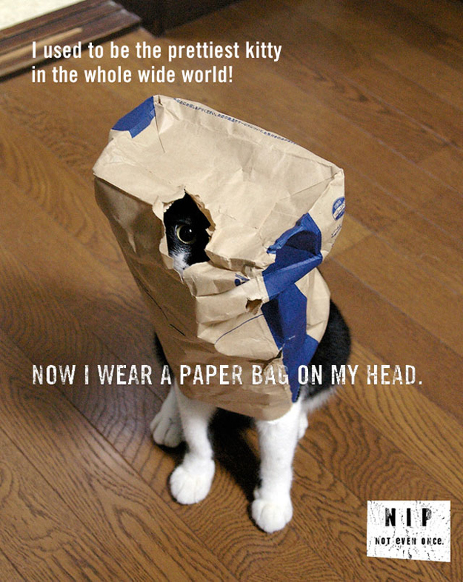

Slide 29
